Slide 1



Slide 2
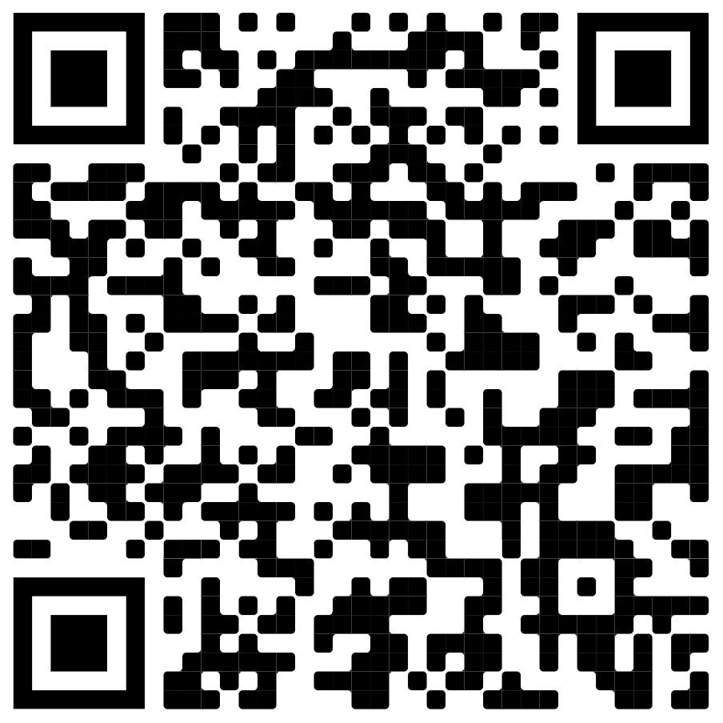
What we have learned so far
Arduino programming
  Input / Output
  Motor driver
  Sensor reading
  Interrupt service routines
  Serial and I2C comms
3D modelling
Some insight into the operation of self balancing robots
(If something is not clear from previous examples you can have a look here → )

Slide 3
Missing pieces of the puzzle
Control system
  General concept
  Practical implementation
  Tuning
Program flow
Misc:
  Sensor calibration
  Complementary filter (combining acc + gyro data into single angle estimate)
  Adding additional components

Slide 4
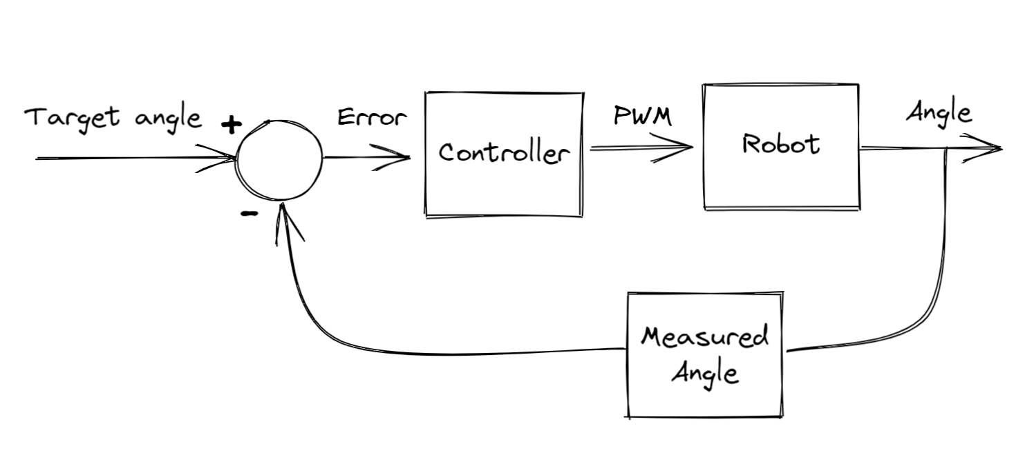
Control system
Input variable (reference signal):
  PWM duty cycle driving the motor
  Logic input for motor direction
Output variable
  Angle of the robot
Goal of controller is to make:
Target angle = Angle

Slide 5
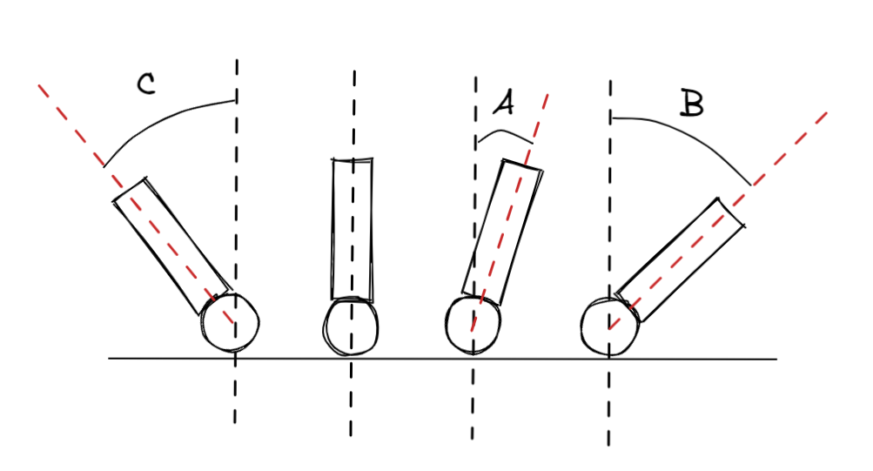
Control system – contd.
For now assume target angle is 0 (robot just standing upright)
In case A we want positive motor direction, low PWM
In case B we want positive motor direction but higher PWM
In case C we want negative motor direction at high PWM

Slide 6
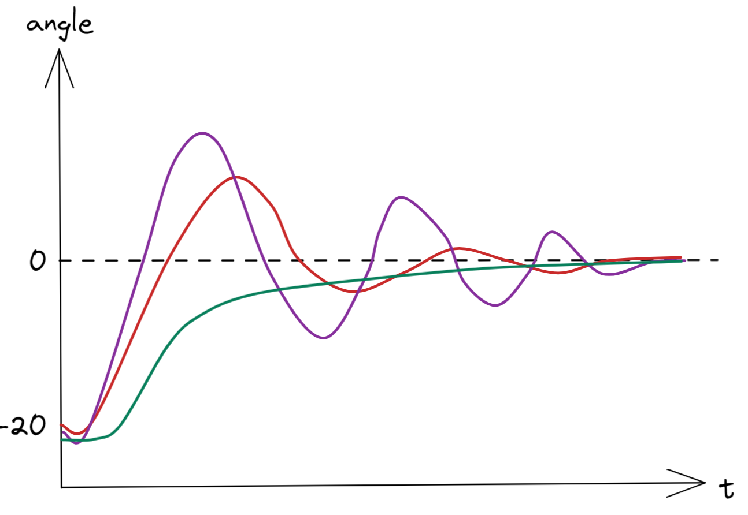

Control system – PID
  Proportional, Integral, Derivative controller
  If a is the angle, PWM is the signal sent to motor drivers
  Where Kp, Ki, Kd are constants that need to be tuned.
  Examine the response plot →

Slide 7
PID, contd.
  Kp
    Proportional to error
    Kp = 1; PWM = a
    Kp = 5; PWM = 5*a
  Ki
    Takes into account error and length of time spent below target. A sort of ‘cumulative’ error
    Large Ki -> reaches target faster, but increased oscillation
  Kd
    Takes into account how quickly the output is changing. ‘Peers into the future’.
    Large Kd -> reduces oscillation and overshoot. Might make it unstable.

Slide 8
Practical considerations
  PWM is limited to [0, 255]
    When computed PWM is negative, need to set |PWM| with reversed motor direction
    When |PWM| > 255, need to set it to 255
  Motors won’t spin at all for low PWM values, good idea to find this value and set PWM in that range

Slide 9
PID tuning
  Set Kp, Kd, Ki to 0
  Increase Kp, until robot oscillates around the 0 degree point
  Slowly increase Ki so that the robot reaches 0 point faster (motors spin faster when angle is larger)
  Slowly increase Kd to reduce oscillations
  Try incrementing each of the parameters up and down and see what works best
  The PID constants will be different for each robot.
  This might be one of the more difficult steps in building the robot. PID tuning is famously frustrating

Slide 10
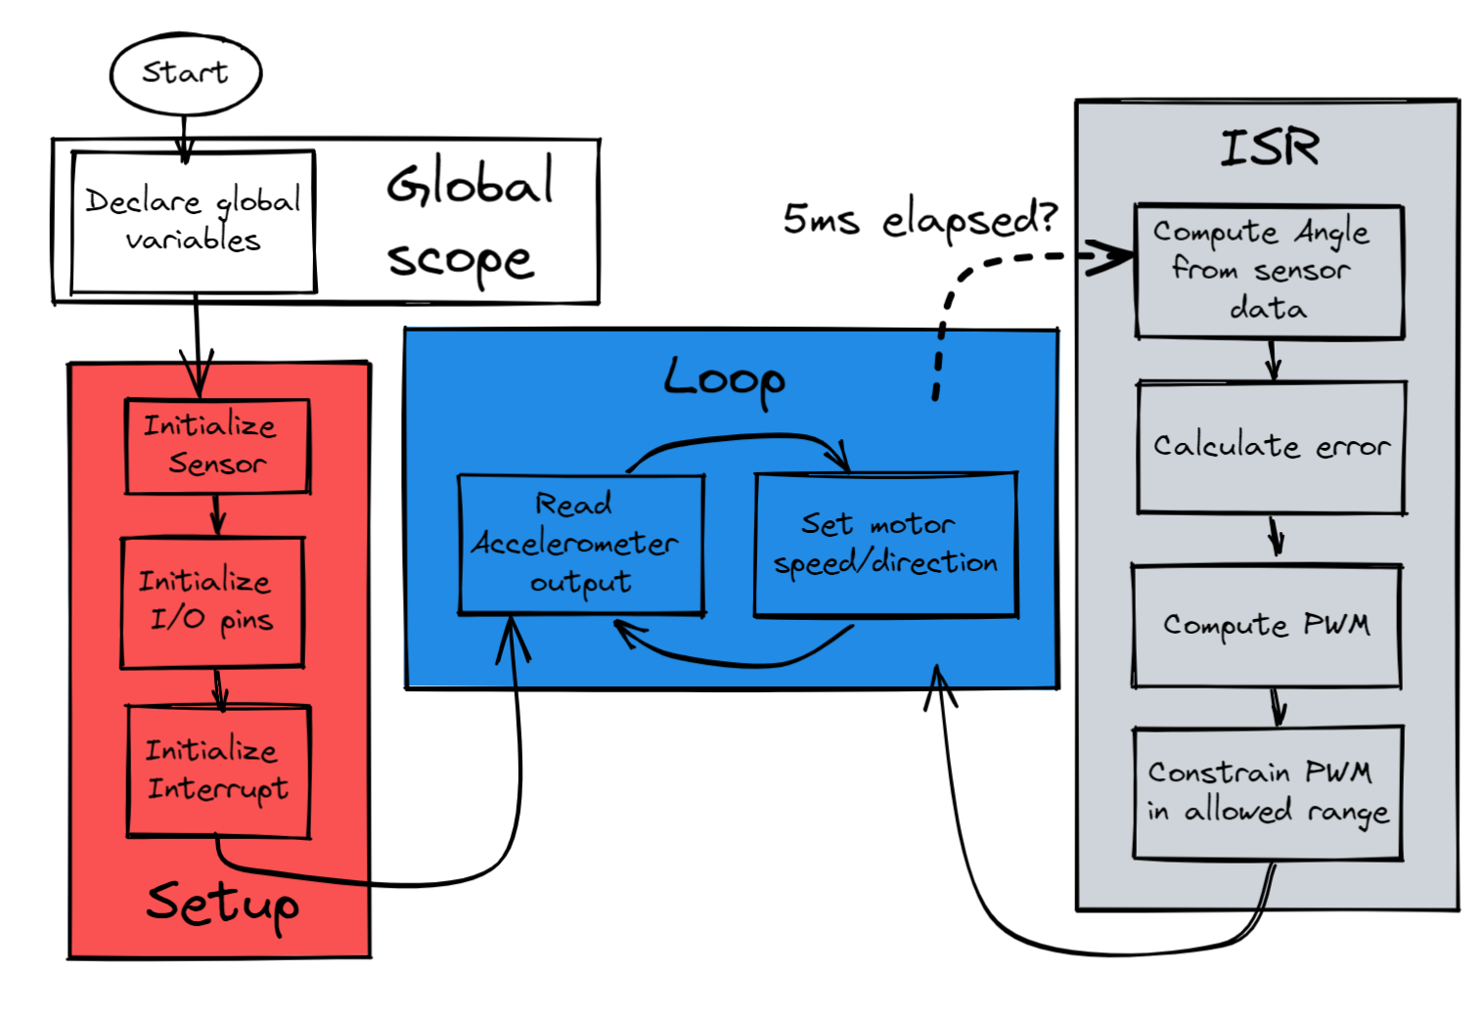
Program
Flow ->

Slide 11
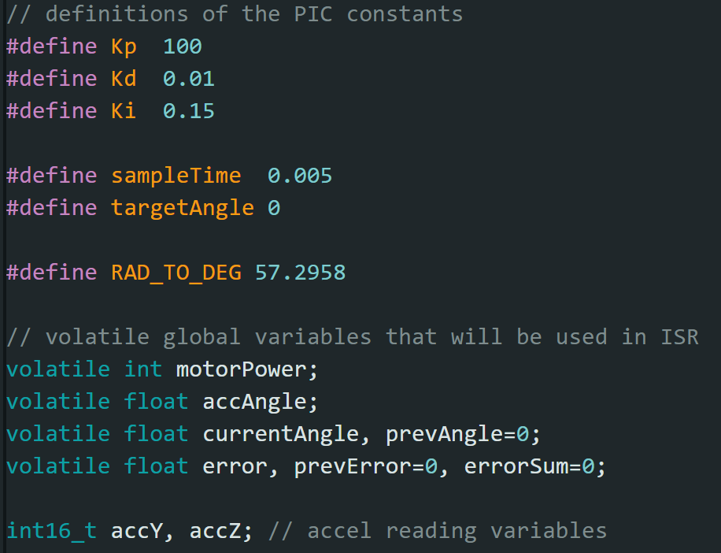
Global scope:
  - Constant values defined with macros (#define)
  - Volatile keyword used for variables whose value could change during the ISR

Slide 12
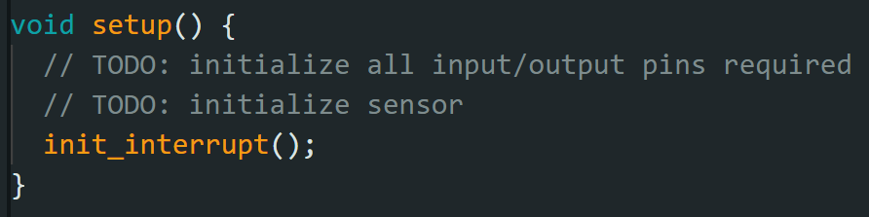
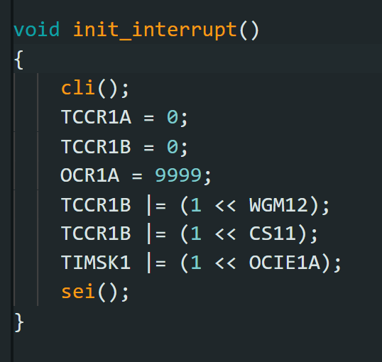
Setup():
  (Here the setup is incomplete, initialization of I/O and sensor is covered in previous session)
  Any other initialization such as Serial.begin(); should be placed here as well

Slide 13
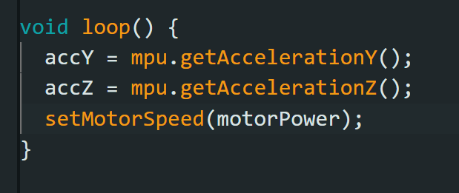
Loop():
  We don’t actually do much in the loop here:
  Read sensor output
  Set motor speed
  A number of other things could be done in the loop:
  Getting a reading from distance sensor
  Blinking some LEDs
  Printing outputs to Serial
  Getting control signals from user (via switches or remote)

Slide 14
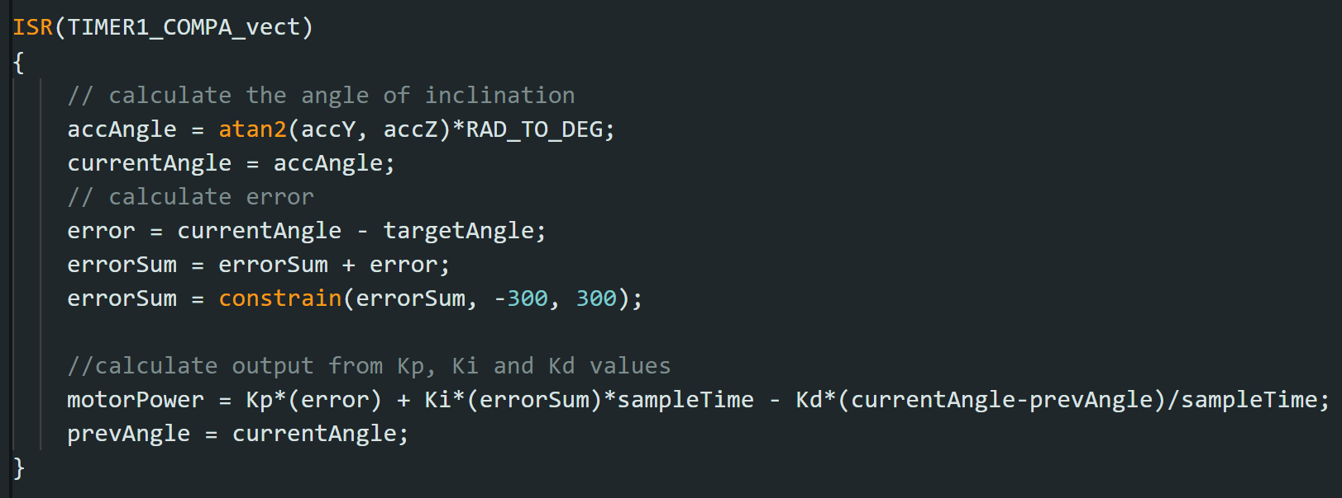
ISR():
  This is where the control system equations live. Note that all operations here are simple maths and assignments (stuff that the Arduino is really fast at)

Slide 15
Final remarks:
  This is essentially, how the final program should look like
  I have shared the example on the drive as PID_example.ino
  The rest of the examples contain chunks of code which will help you with filling out the ‘TODO’ sections in the PID_example
  Next step - get building ☺
  Useful resources:
  instructables.com / arduino.cc – contain user submitted projects that might be useful to take inspiration from
  the drive – contains all the examples I’ve discussed during these sessions as well as presentations

